Slide 1
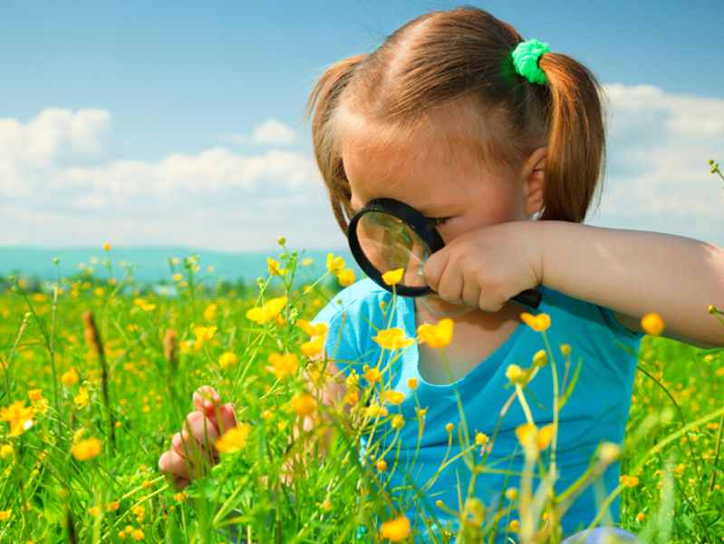
Investigating the
Seasons

Slide 2
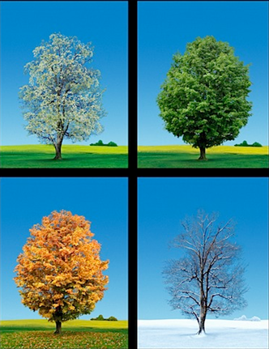
Winter
1
2
Summer
Fall
3
4
Spring
There are four seasons in a year. They are winter, spring, summer, and fall.

Slide 3



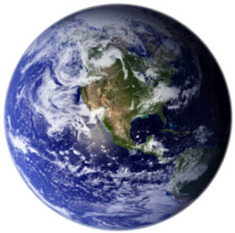



The weather changes during each season. What are some of the changes?

Slide 4

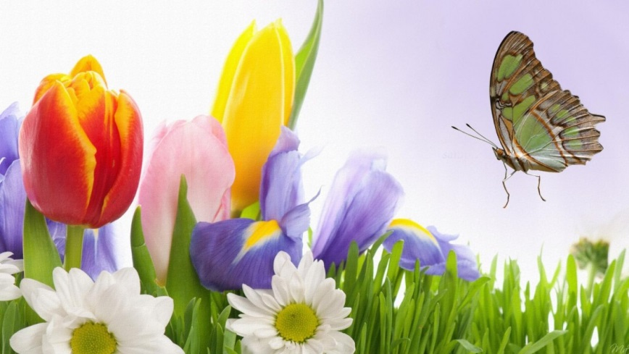

How do we know when it is spring?
Let’s investigate!

Slide 5
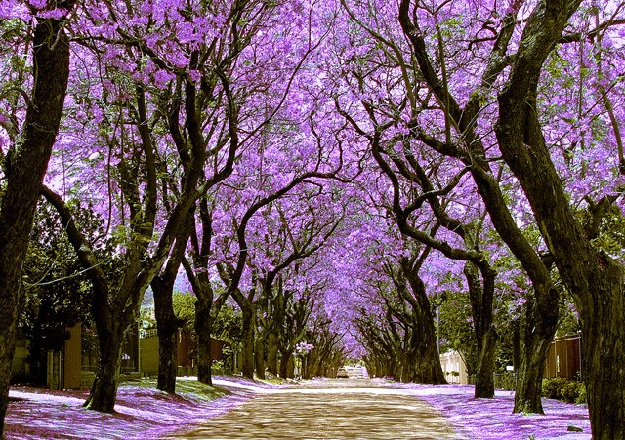
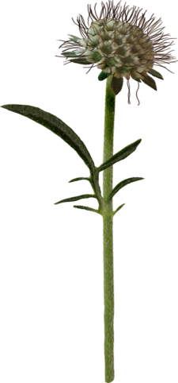

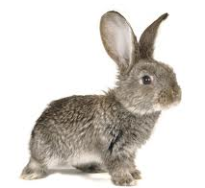

In spring, we can see new leaves and buds on the trees. We can hear baby birds chirping. We can feel the drops of rain. We can smell the flowers in the gardens. We can taste the delicious strawberries picked from the fields.

Slide 6

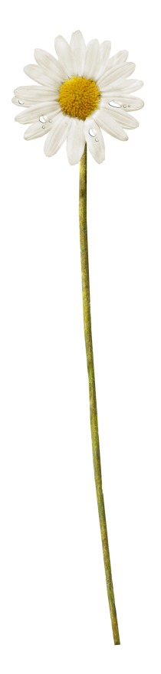



How do we know when it is summer?
Let’s investigate!

Slide 7

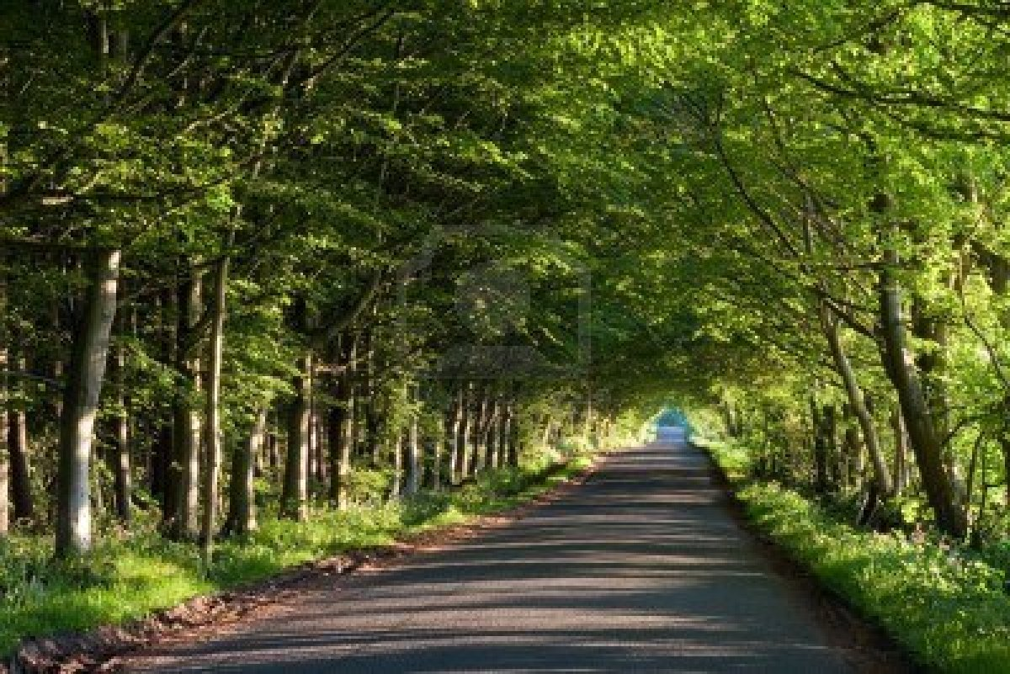









In summer, we can see many green leaves on the trees. We can hear bees buzzing from flower to flower. We can feel the days grow warmer and warmer. We can smell fruit ripening on the trees. We can taste yummy ice cream during a picnic in the park.

Slide 8






How do we know when it is autumn?
Let’s investigate!

Slide 9
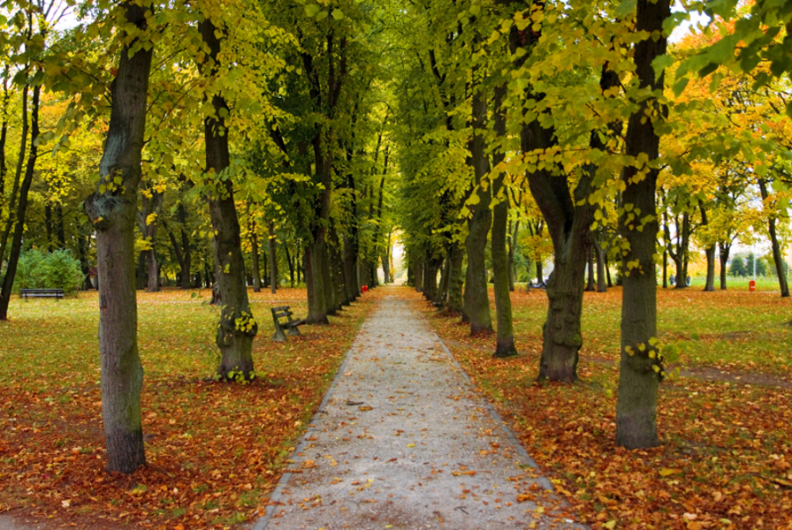
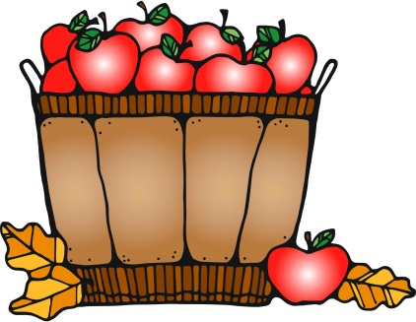



In autumn, we can see the colorful leaves falling from the trees. We can hear their crunch under our feet. We can feel the wind blowing our hair. We can smell the pumpkin pie baking in the oven. We can taste the freshly picked apples.

Slide 10




How do we know when it is winter?
Let’s investigate!

Slide 11

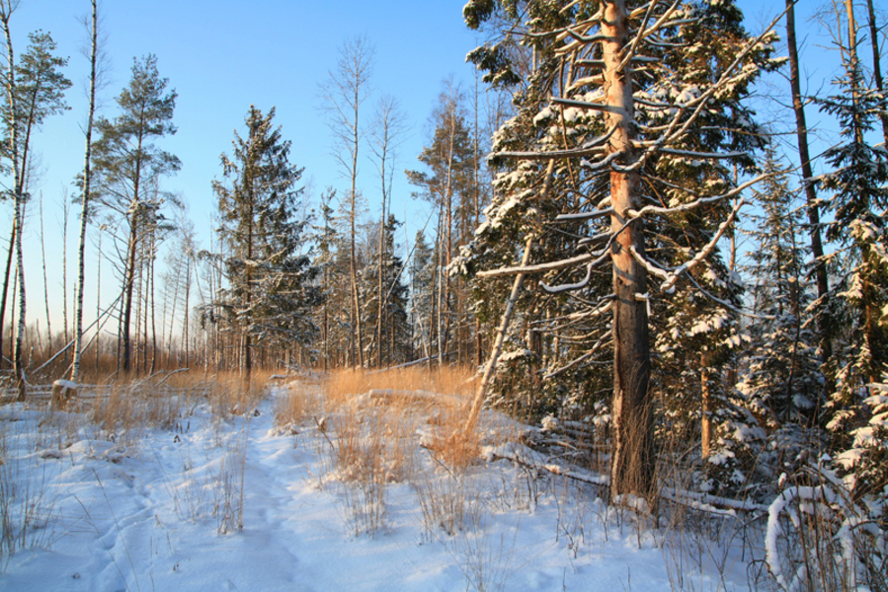


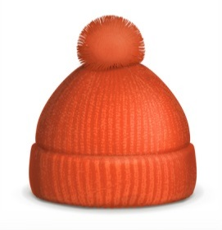
In winter, we can see the bare trees. All their leaves are gone. We can hear the crackling of the warm fire. We can feel the cold air nip at our nose. We can smell the hot cocoa in the cup, while snowflakes fall all around us.

